Slide 1
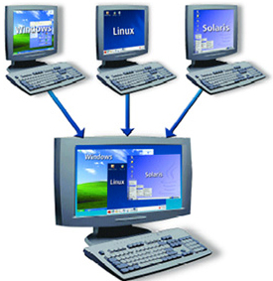
Containers
Docente: Dott. Daniele Gobbo Modulo 1

Slide 2
CONTAINER & NETWORKS
We'll dive into a never key concept which you will need in most applications.
We're going to dockerize and that will be networks and how you can use networks from inside your containers.
This mean how we can connect multiple containers
But also:
How we could connect an application
running in a container to our local host machine
For example:
send HTTP requests to some other service running on your machine.
And also how you can reach out to the world wide web from inside your container.

Slide 3
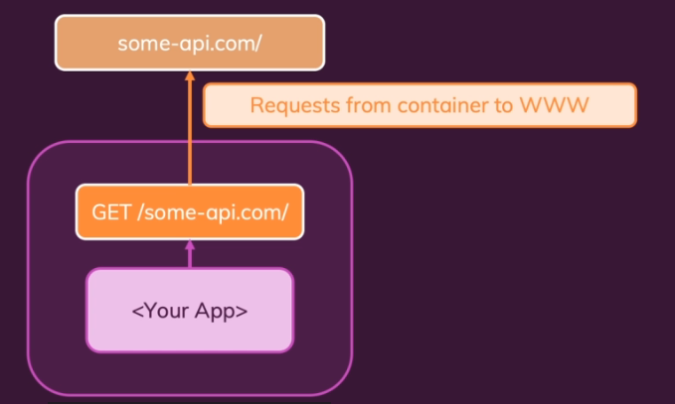
CASE1-CONTAINER TO WWW COMMUNICATION
PLEASE OPEN WITH VISUAL STUDIO CODE «network starting setup» folder

Slide 4
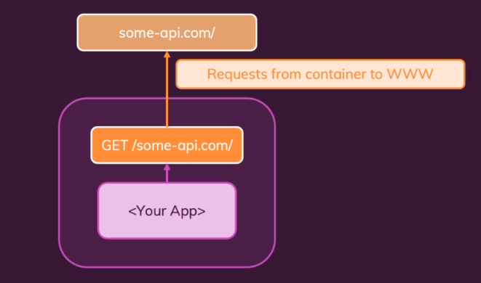
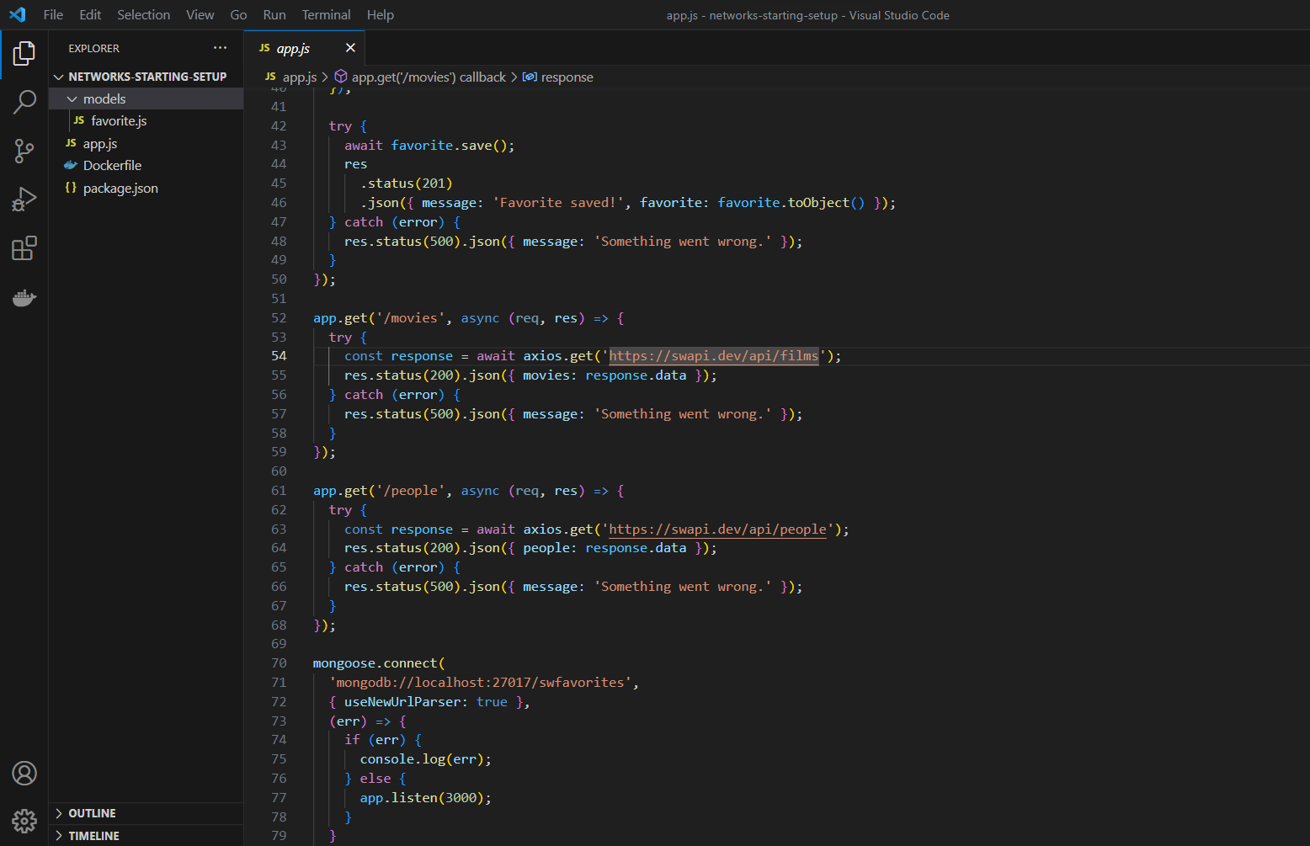
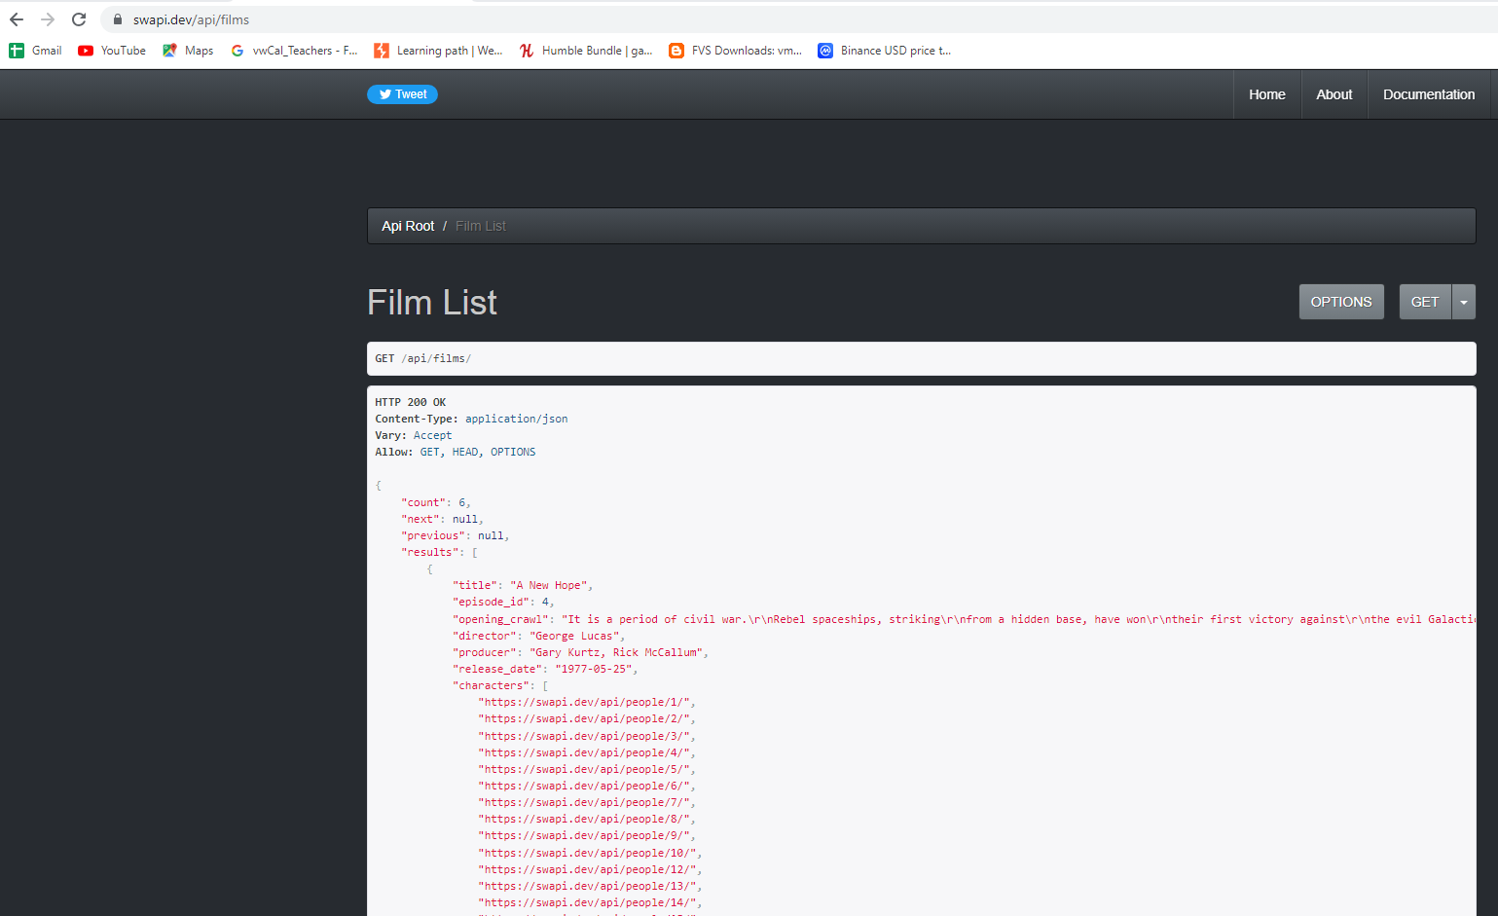
CASE1-CONTAINER TO WWW COMMUNICATION
Axios, which is a third party package, which has also mentioned in package.json as a dependency.
I'm using Axios to send a GET request to this Star Wars API here.
And this is not an API created or owned by us.
It's not a Docker container.
It's a website in the end, a web API, which you can also visit.
For example, swapi.dev/api/films will yield some data, some information about the Star Wars movies.
So this is simply a dummy API which we can use to play around with it in dummy demo applications
I just want to highlight already that this is a Node application that sends an HTTP request
to some other website in this case, and therefore will definitely have HTTP communication between this app and this Star Wars API website.
And if we put this Node app into a container, we need to ensure that this request can still be sent and that it can go from inside our container to outside the container.
So that is one possible way of communicating in a dockerized app:
Sending an HTTP request to some other website or web API.
This application ”app.js” will actually create another API, which then will live in a container later, this API, which we are building here, will reach out to another API, this Star Wars API to fetch movie and character data from there.

Slide 5
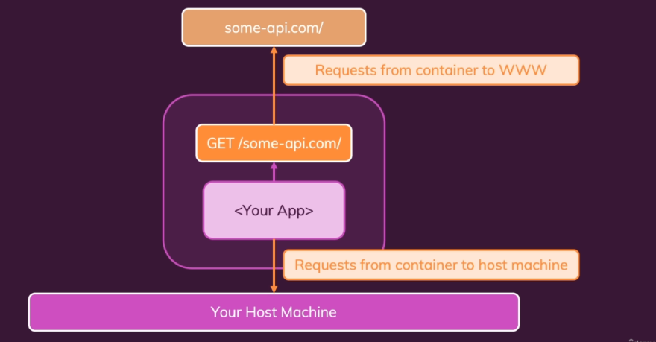
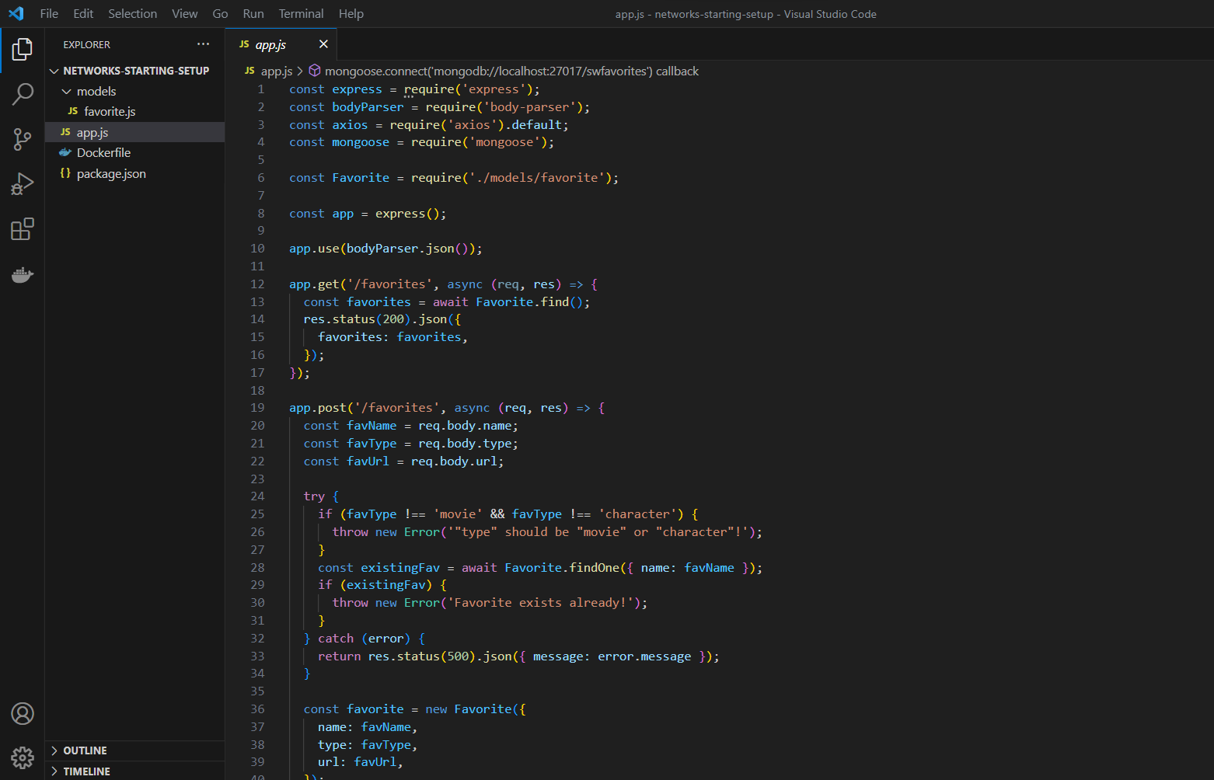
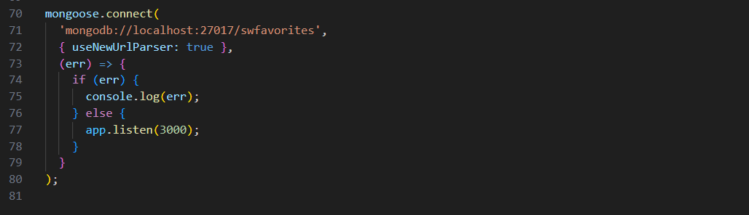
CASE2-CONTAINER TO LOCALHOST MACHINE COMMUNICATION
We do not just have code to talk to this Star Wars API.
We also have code to fetch and store data in our own database.
And therefore we also have code to connect to this database.
In this case, we're going to use MongoDB which is a quite popular database engine.
You could say a database solution, which we can use and we're going to connect to a Mongo database here which runs on our host machine.
Maybe we also have something on our hosting machine, some web service or a database, anything like that, and we wanna talk to that from inside our dockerized app.
So we then still want to communicate with something outside of the container but something is not a website or anything like that, but instead it's a service running on our host machine. Just not a service in a network container
let's say, but simply a database

Slide 6
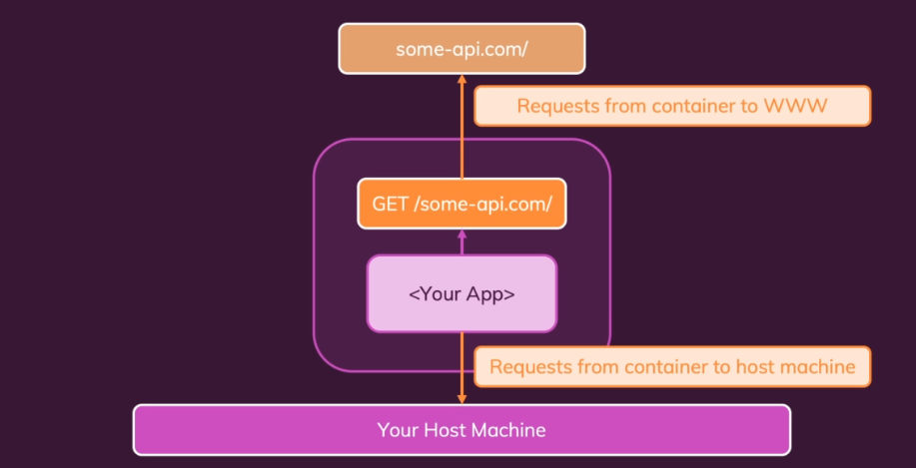
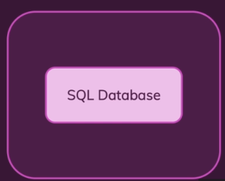
CASE3-CONTAINER TO CONTAINER COMMUNICATION
you could encounter in your Dockerized app that would be that your application running inside of your container wants to talk to another container.
So communication between multiple containers is also a quite common scenario
it is strongly recommended and the best practice that every container should just do one main thing.

Slide 7
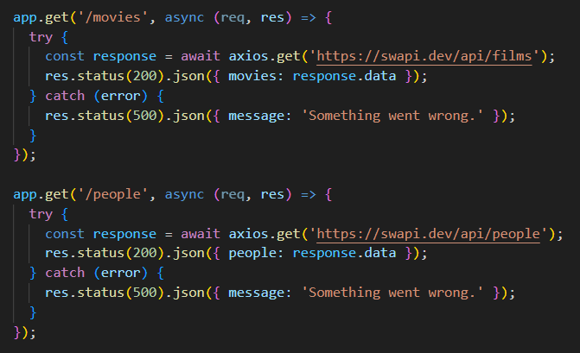
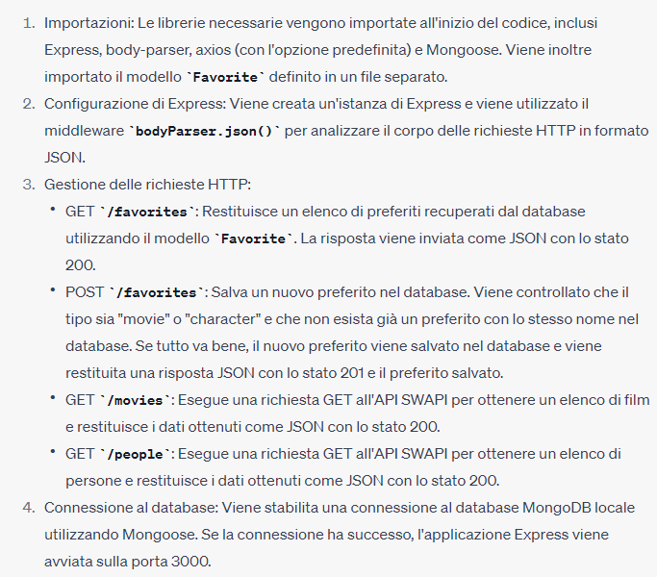
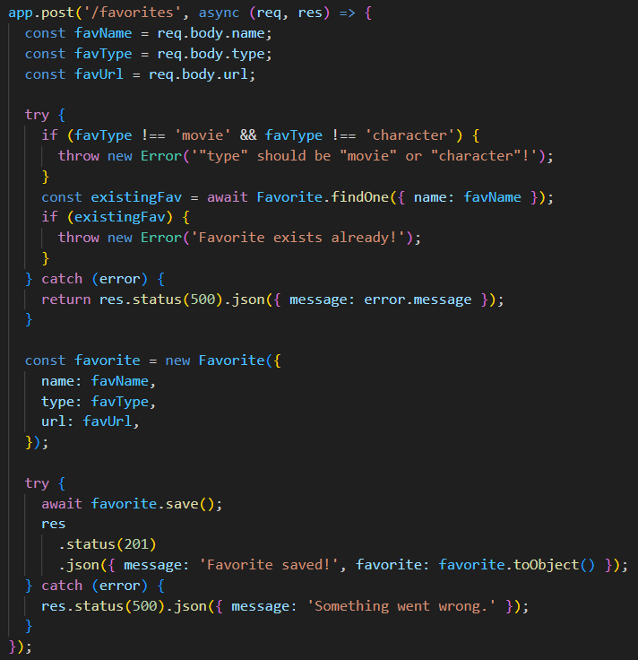
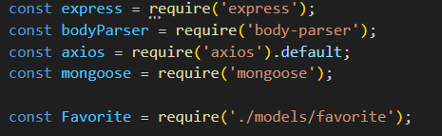
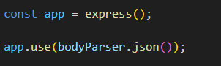
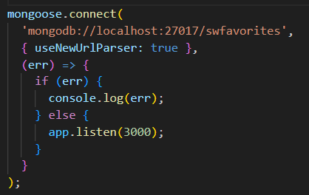
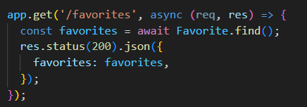
ANALIZING THE DEMO APP
I will start this application
and it won't work on your system.
because you will need MongoDB to be installed for that.
You don't need to install MongoDB now,
because we're going to dockerize this anyways
Therefore you can't run this code
but we're going to put it into a container anyways.
Let put it into a container……

Slide 8
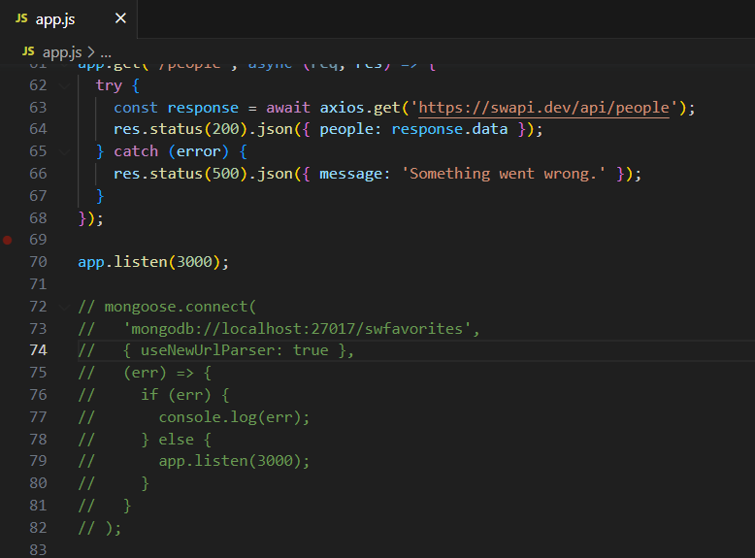
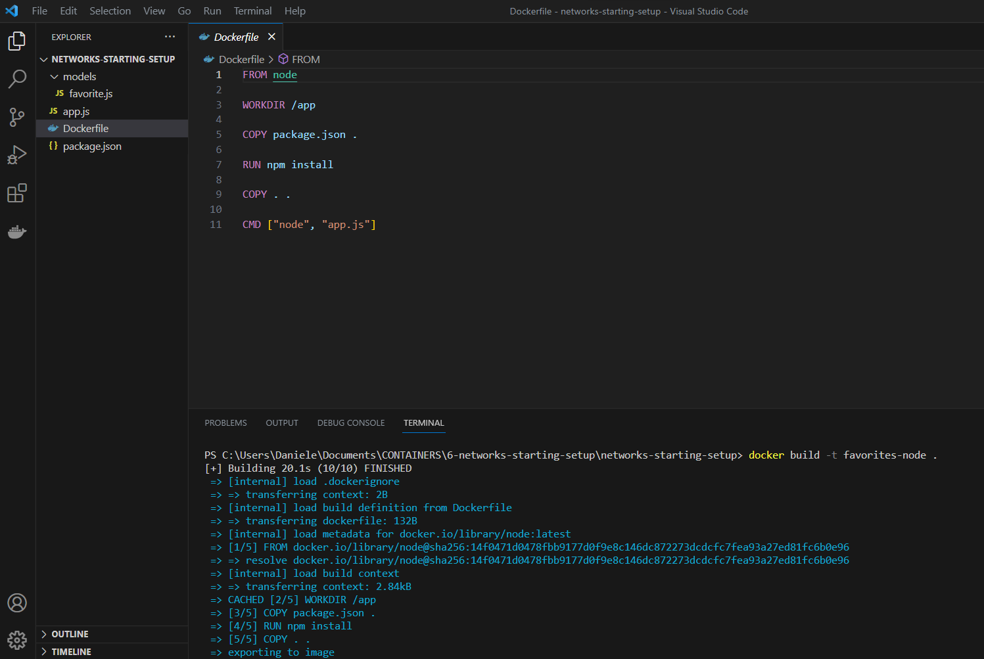
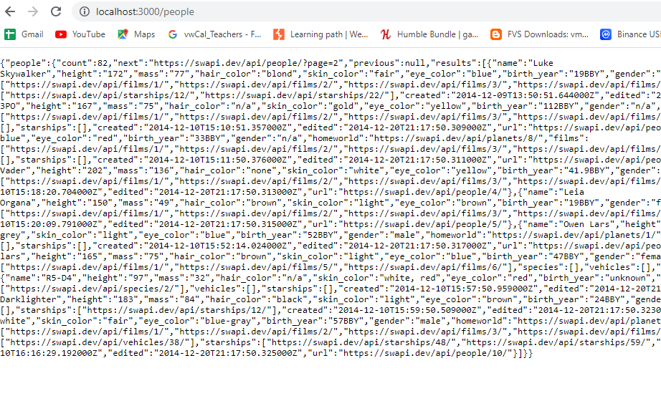
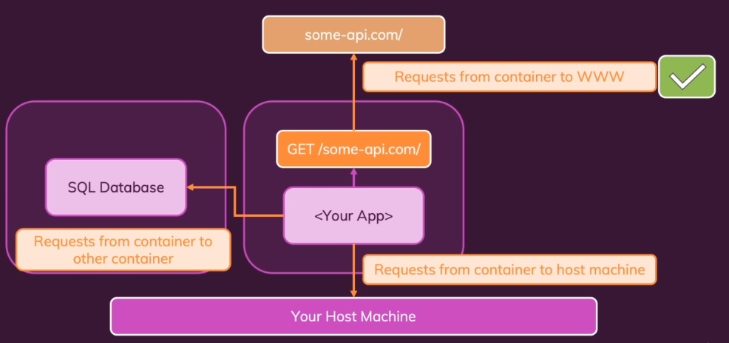
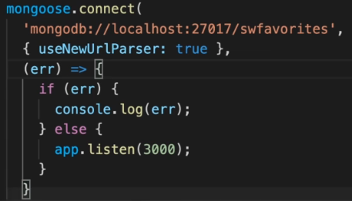
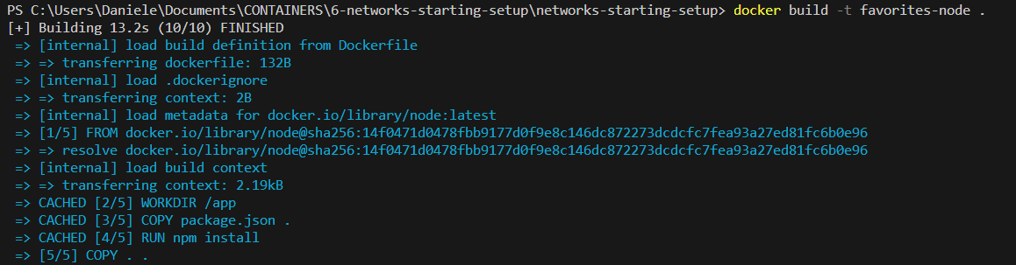
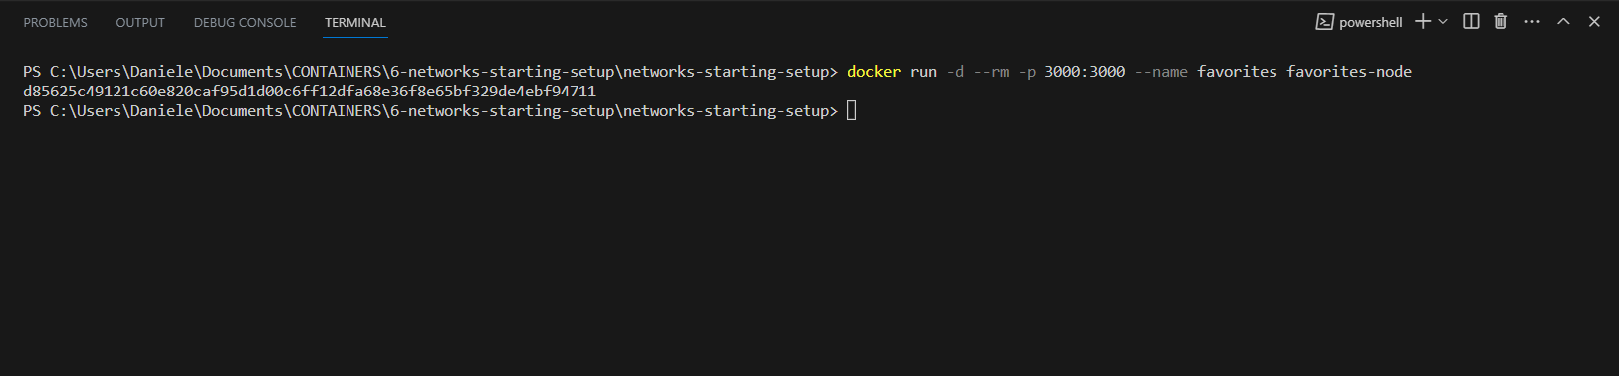
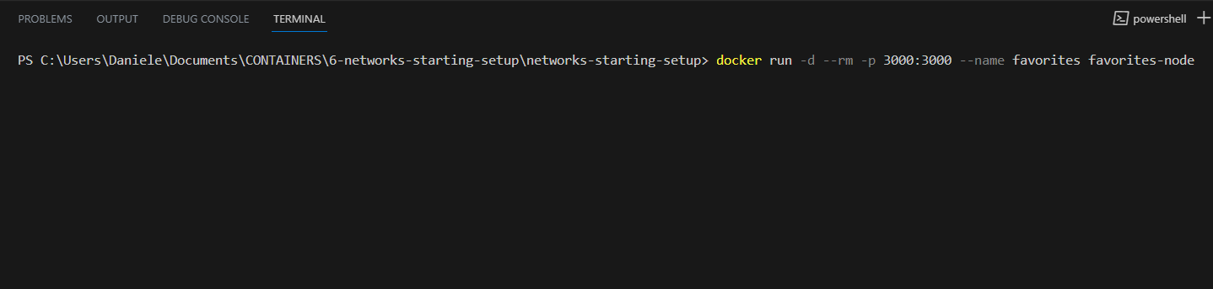
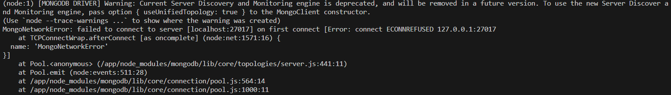
CREATING A CONTAINER & COMMUNICATING TO THE WEB (WWW)
We need no volume because this application does not write anything to any file which would need to survive a container shut down and removal.
There is nothing which needs to survive that
except for the data stored in the database,
but that database is not part of this container
if I now have a look at my running containers
with docker ps, I see no containers there.
Containers can send requests to the World Wide Web.
You can communicate with web API's and web pages from inside your dockerized applications.
Sending requests from inside your container
to the World Wide Web just works.
It works out of the box without any special setting
Before we look into fixing this,
I want see if sending HTTP requests
to some other website would work.
And in order to test this, we can copy app listen 3000 here and move that out of this mongoose connect code and temporarily comment this mongoose connect code out.

Slide 9
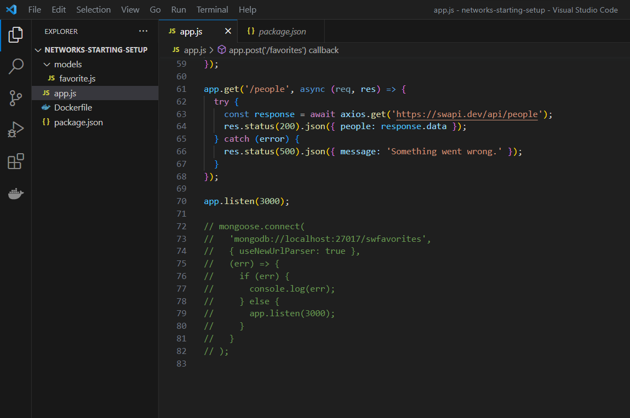
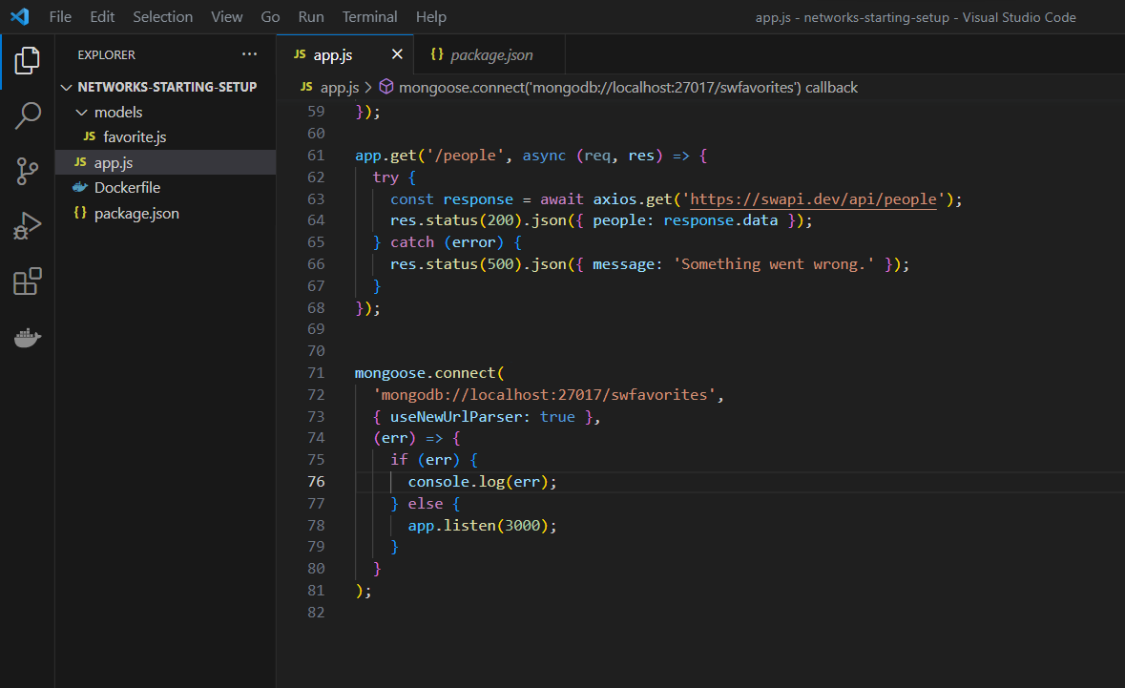
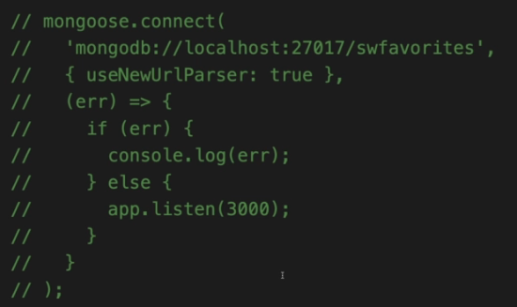
MAKING CONTAINER TO HOST COMMUNICATION
Sending HTTP requests to outside APIs works,
but what about services or servers running on our local host machine?
At the moment, this is not working, which is why I had to comment this code out
now I want make sure that our Dockerize application is able to talk to my locally installed MongoDB database.
WE need to install MONGODB on our local machine…..
Please remove comment and app.listen(3000) on top of this code….

Slide 10
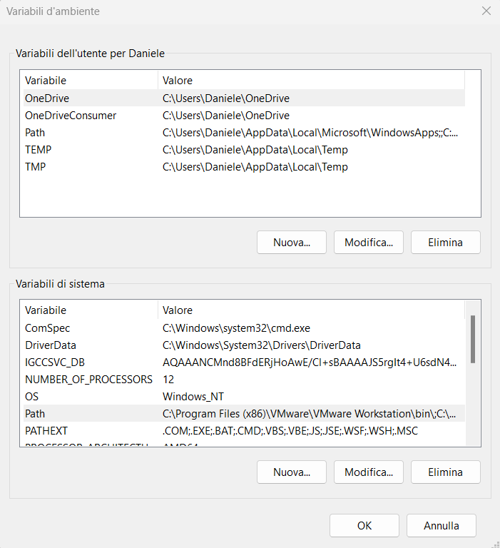
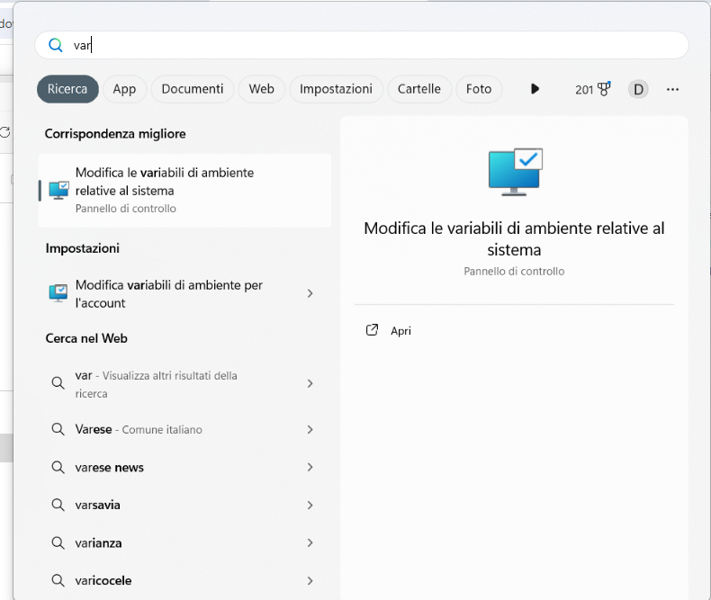
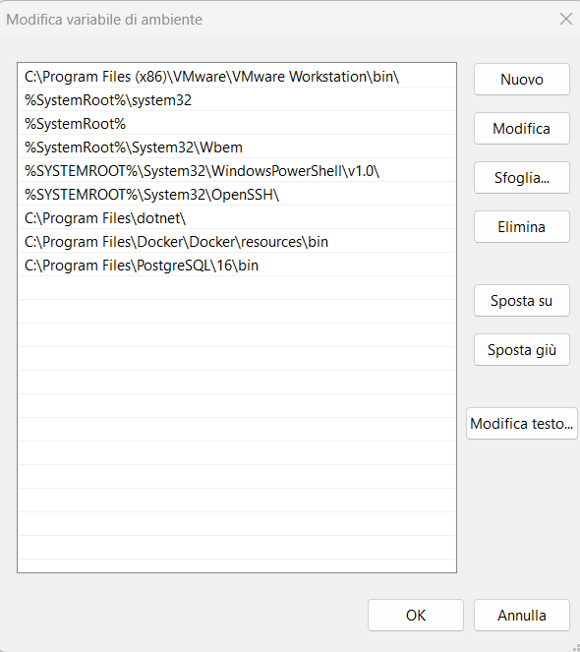
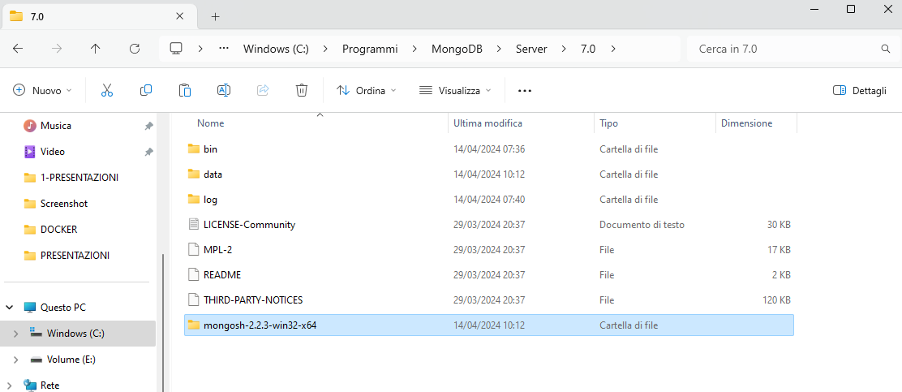
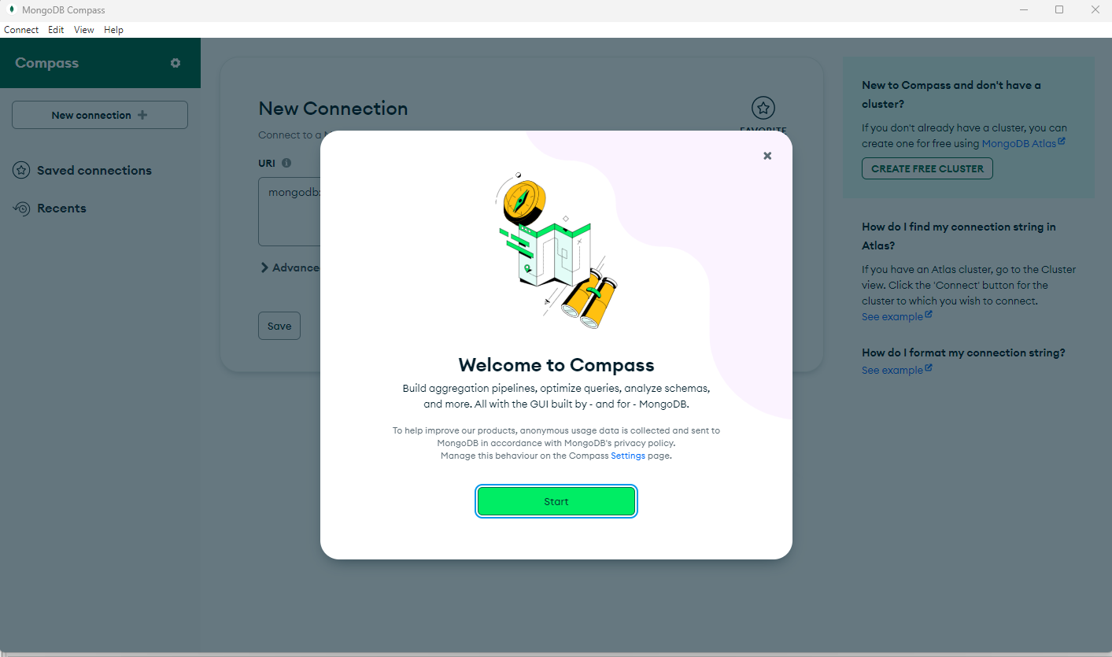
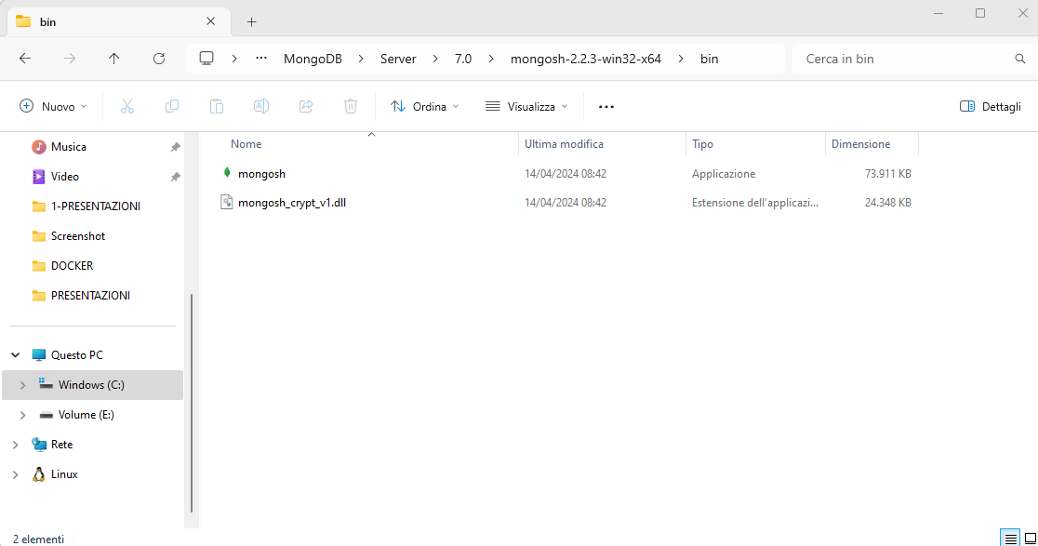
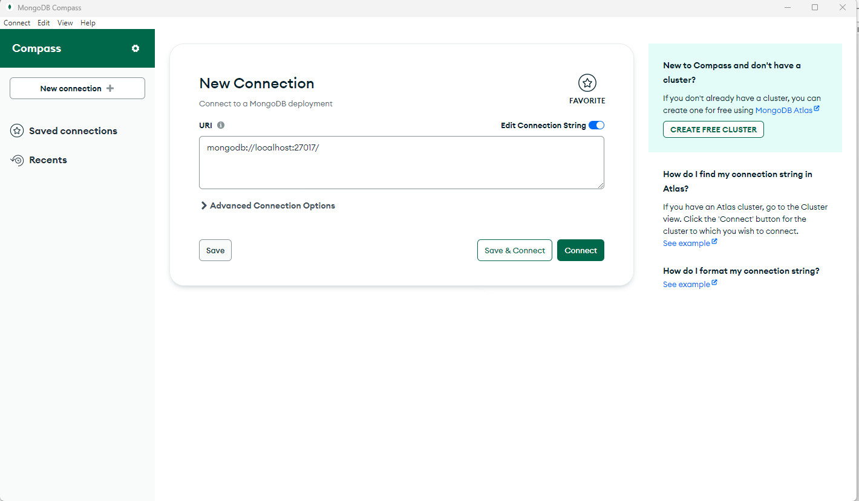
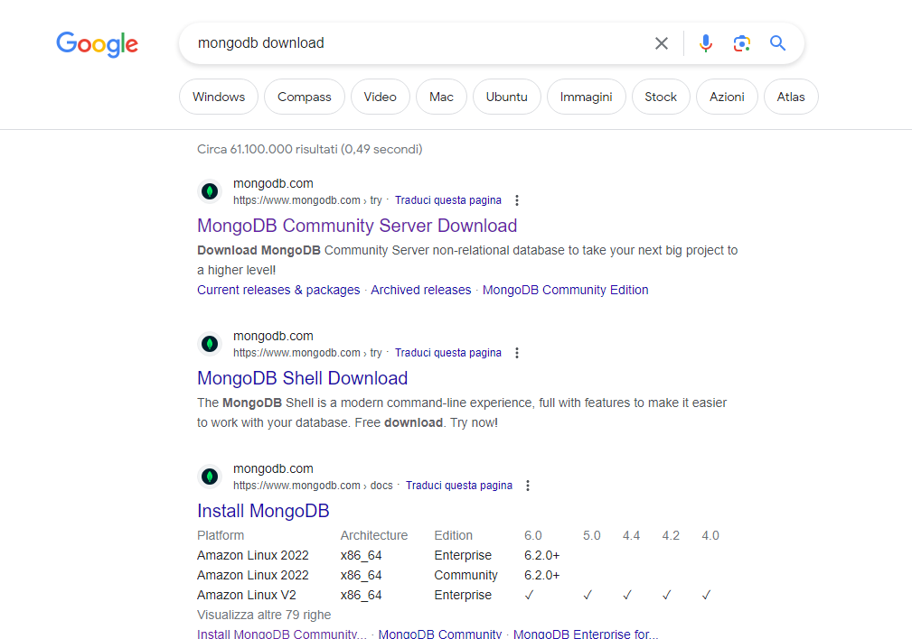
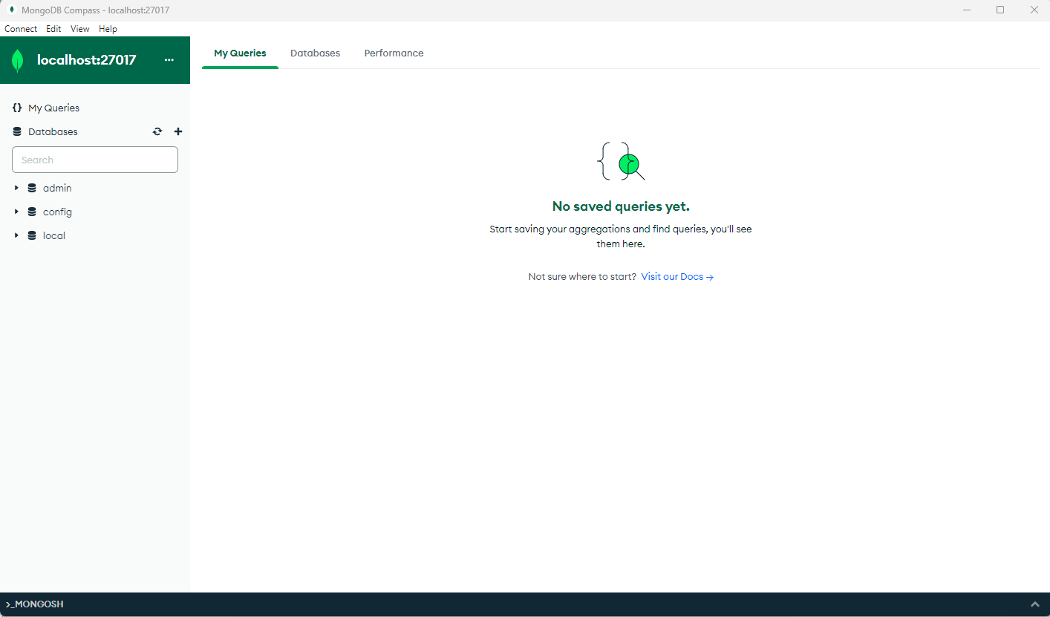
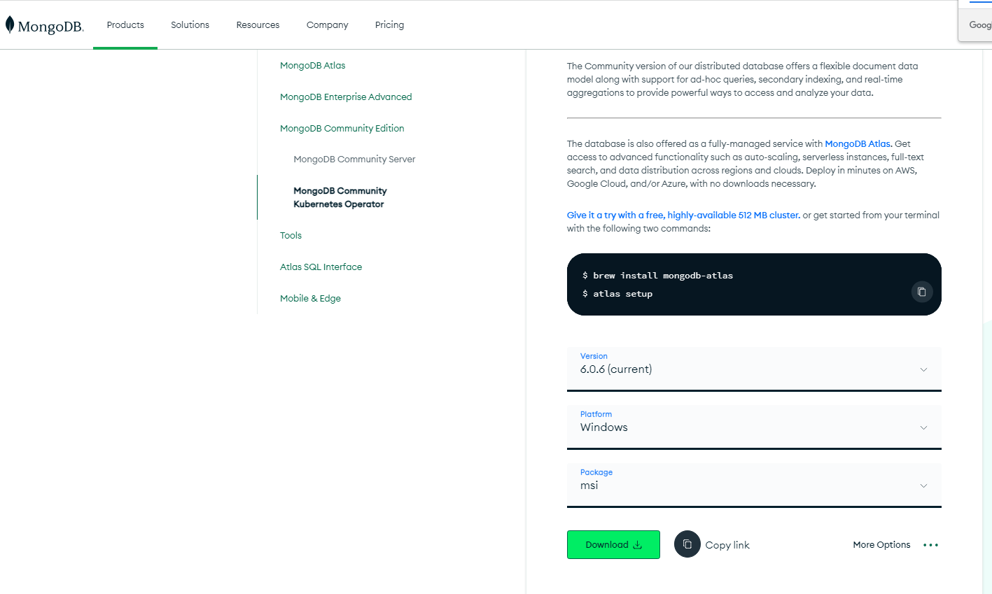
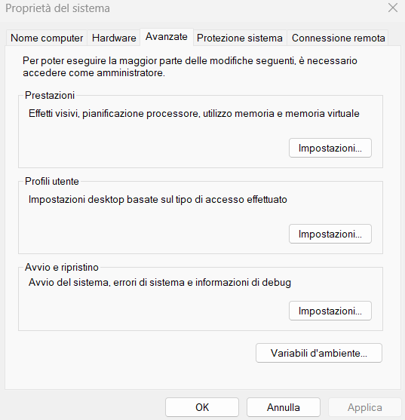
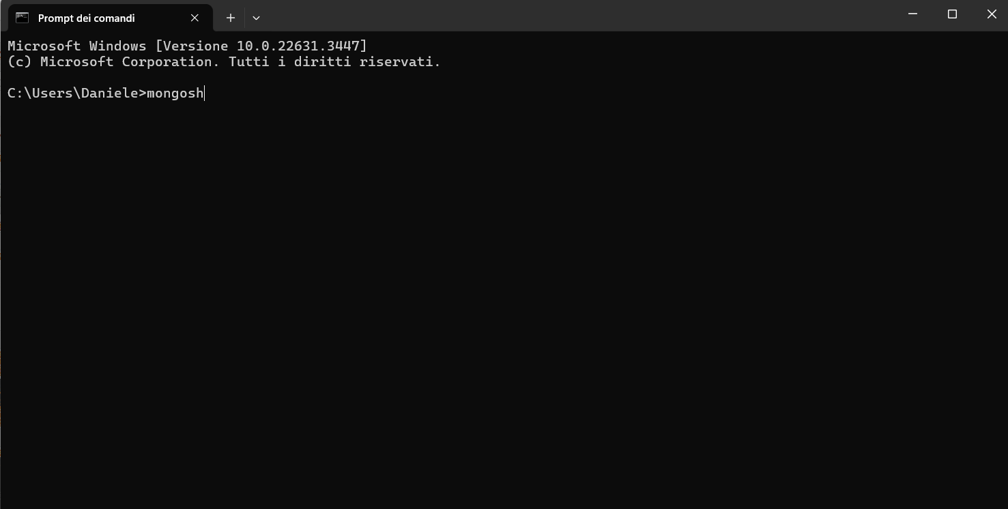
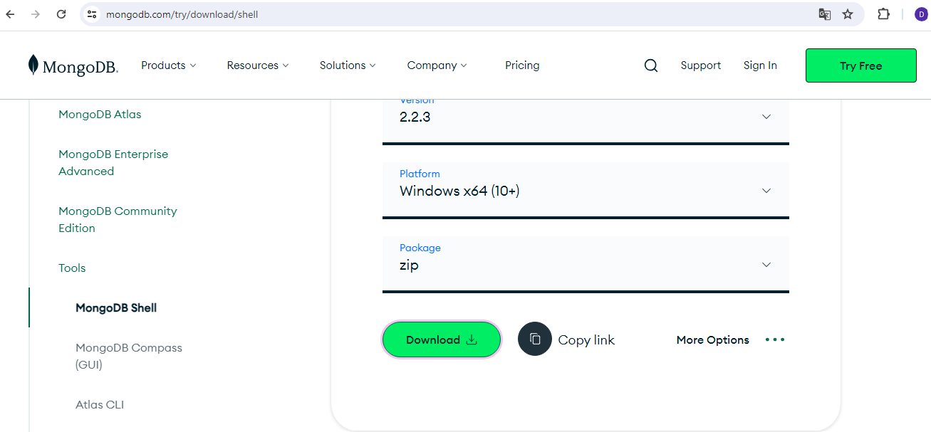
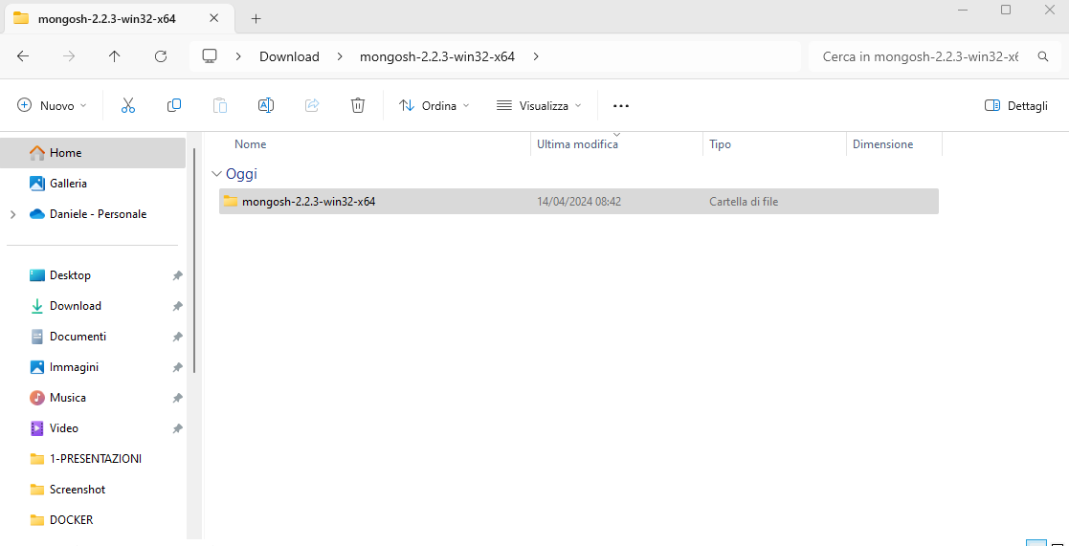
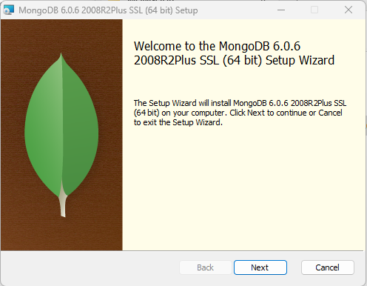
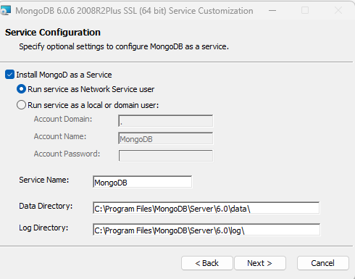
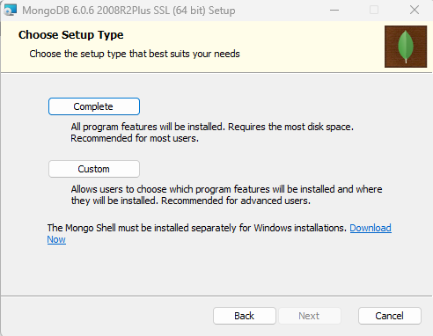
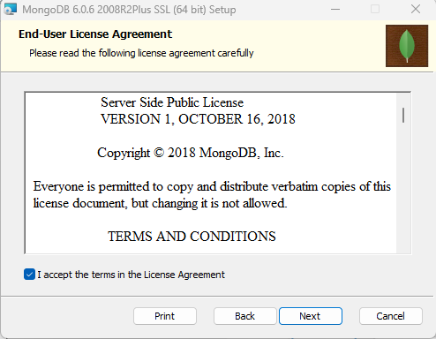
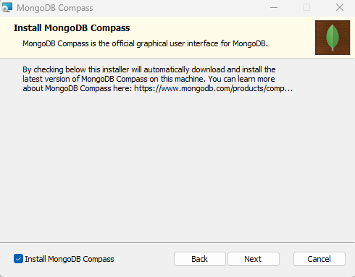
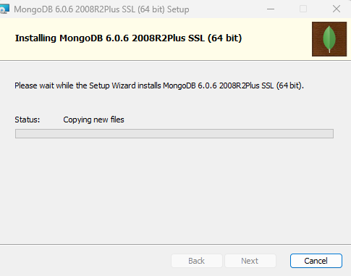
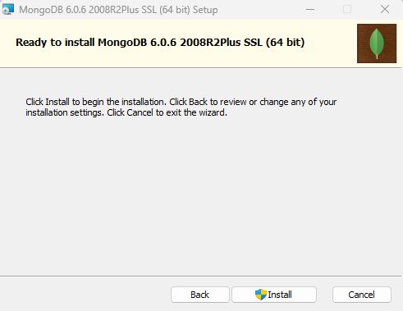



INSTALL MONGO DB ON LOCAL MACHINE
Please copy it amd move to this directory…
Copy this path
Now we need install mongo shell «mongosh»
Open it, and enter on bin directory

Slide 11


MONGODB INTRODUCTION
EQUIVALENT TO RECORDS
GROUP OF COLLECTIONS
EQUIVALENT TO TABLES. CONTAINS COLLECTION OF DATA

Slide 12




MONGODB CREATE COLLECTIONS AND INSERT DATA
This command create a collection «utenti»
This command insert a document on the collections

Slide 13


MONGODB CREATE COLLECTIONS AND INSERT DATA

Slide 14












MONGODB SELECT AND FILTER DATA

Slide 15



MONGODB UPDATE AND MODIFY DATA
FILTER

Slide 16


MONGODB UPDATE AND MODIFY DATA

Slide 17


MONGODB UPDATE AND MODIFY DATA

Slide 18


MONGODB UPDATE AND MODIFY DATA

Slide 19

MONGODB DELETE DATA

Slide 20

MAKING CONTAINER TO HOST COMMUNICATION
And for communication between your Dockerize application and your code in your Docker container and our local host machine
for this kind of communication, we really only need to change your code in here.
You need to replace local hosts with a special domain, which is understood by Docker and that's host.docker.internal.
This special domain is recognized by Docker.
It's understood by Docker.
And it's translated to the IP address of your host machine as seen from inside the Docker container

Slide 21


MAKING CONTAINER TO HOST COMMUNICATION
To see GET and POST Operations we can use POSTMAN
Postman is an API Platform for developers to design, build, test and iterate their APIs

Slide 22














INSTALLING POSTMAN API PLATFORM
I'm now successfully talking to this MongoDB database which runs on my host machine
PLEASE CLICK HERE AND CREATE A NEW ACCOUNT….
Now we want to try a POST Command to retrive data…..

Slide 23










CONTAINER TO CONTAINER COMMUNICATION: BASIC SOLUTION
Now we want to have 1 container for the node app
and one container for the MongoDB database
So this cross container communication works.
But of course, it's not very convenient.
We had to look up the IP address of the our container in order to then use it here.
Definitely not a lot of work, but still quite cumbersome.
It also means that we always have
to build a new image whenever the MongoDB container IP address changed, because we hard code that IP address here ,in the node app
and this of course, is not ideal
There is an easier way of having multiple Docker containers talk to each other……
it is strongly recommended and the best practice that every container should just do one main thing.
I get back a response with an empty favorites array.
The fact that it's empty makes a lot of sense,
because this no longer is my MongoDB database
on my host machine but instead, this is a brand new MongoDB database in our MongoDB container and therefore it of course does not have access to the data stored in my local host MongoDB database.
It's a totally separate, isolated database.
We can communicate here, we don't get an error and that shows that our approach works,
and that the two containers are able to talk to each other
I want to alter my node js application code such that we can connect to this database running in this upper container and that's now the tricky part, host.docker internal will no longer work, because that refers to my local host machine IP address, not to the IP address of some other container
This is the IP address of your container and this IP address can be used to contact this container.
I want to put my MongoDB database inside of a container.
So I will no longer use the locally installed one
Let's start by creating a MongoDB container….

Slide 24










ELEGANT CONTAINER TO CONTAINER COMMUNICATION
The other Docker container's name
will also be translated by Docker
to the IP address of that container
With this --network option, if I hit enter,
I get an error that the network favorites net is not found.
Unlike with volumes, for networks,
Docker will not automatically create them for you
If you want to run a container using a network, instead you have to create them on your own.
The idea is that you might have multiple containers and you want to allow communication between these containers.
With Docker, you can put all these containers into one and the same network by adding the --network option on the Docker run command.
This creates a network in which all containers are able to talk to each other.

Slide 25




QUIZ TIME

